Slide 1
iSoulful Music Submitted by:-Dushyant Bhardwaj Presented to:- Mr. Akash Verma

Slide 2
What Is iSoulfulMusic
iSoulful Music is a music player app in which we can play music offline(internal or external storage).
There are many functions used in this app. User can play, skip next, previous and pause the music.
In this project XML and Java is used. User can seek the duration of the music. When user will install this player app will start searching music in your phone. This app is only made for refreshing mind and for entertaining purpose.

Slide 3
Front End Activity Layout
Front Activity Layout is used for how the app will look like when user will open.
On The First Activity Layout I used ListView and constraint.

Slide 4
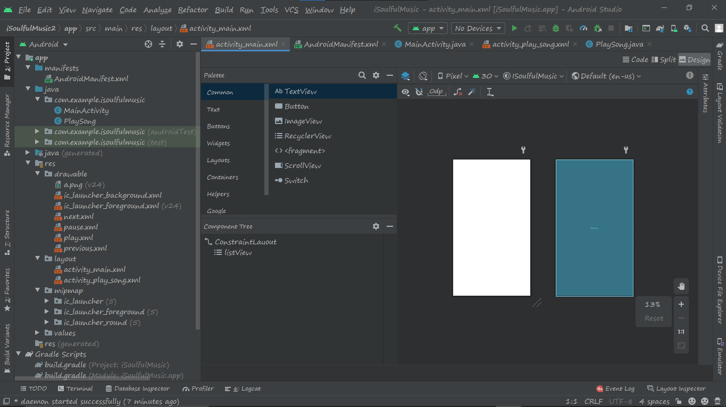

Slide 5
Android Manifest
Android Manifest is in xml form which is used to give permissions to phone for allowing media files and folders. It is also used for multiscreen apps.

Slide 6
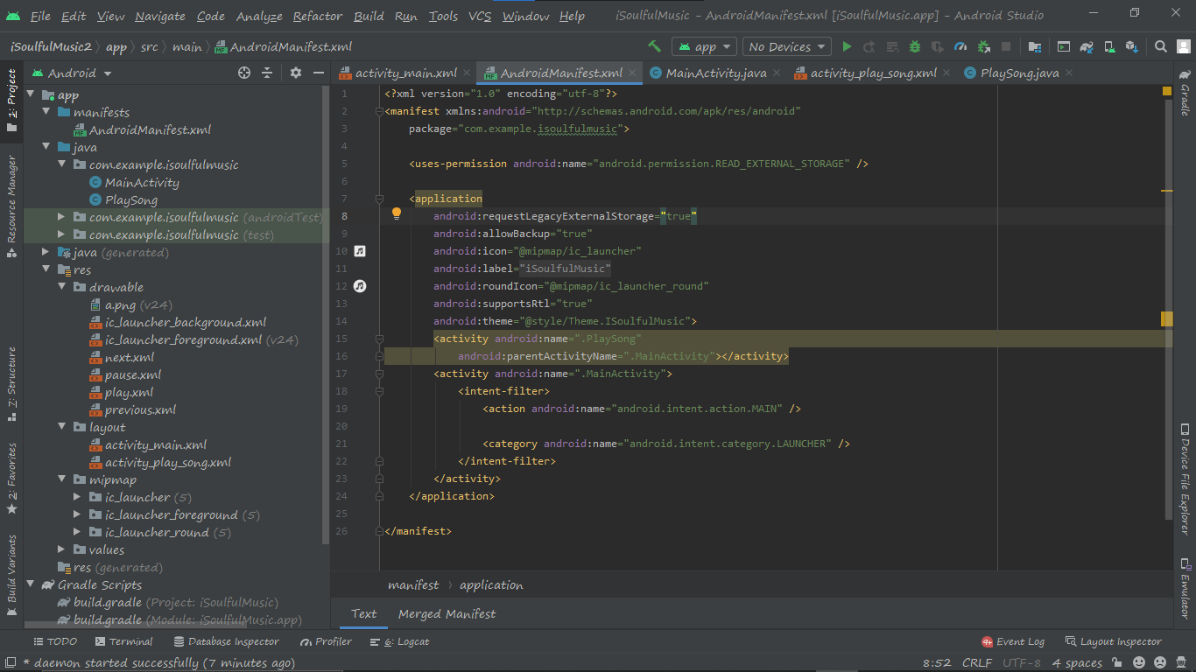

Slide 7
Backend Java File For Activity
Java file is used for making the listview in activity 1. It is used for to showing the list in order way. First I gave the permission to allow the media files folders by android manifest and then I gave a toast. Toast is used for giving the feedback for two seconds. It’s only tell the function or anything is working or not like example I inserted toast to check whether it is allowing the media files or not. If it’s working then it shows me runtime permission given otherwise it crashed. Array adapter is used to making an array in simplest form so that we can see a list of songs simply.

Slide 8
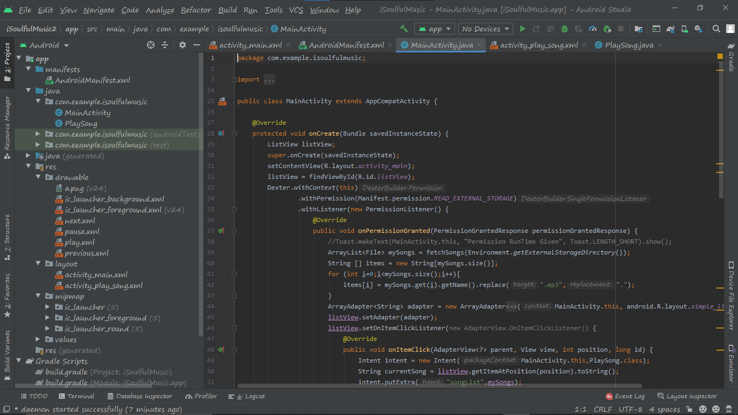

Slide 9
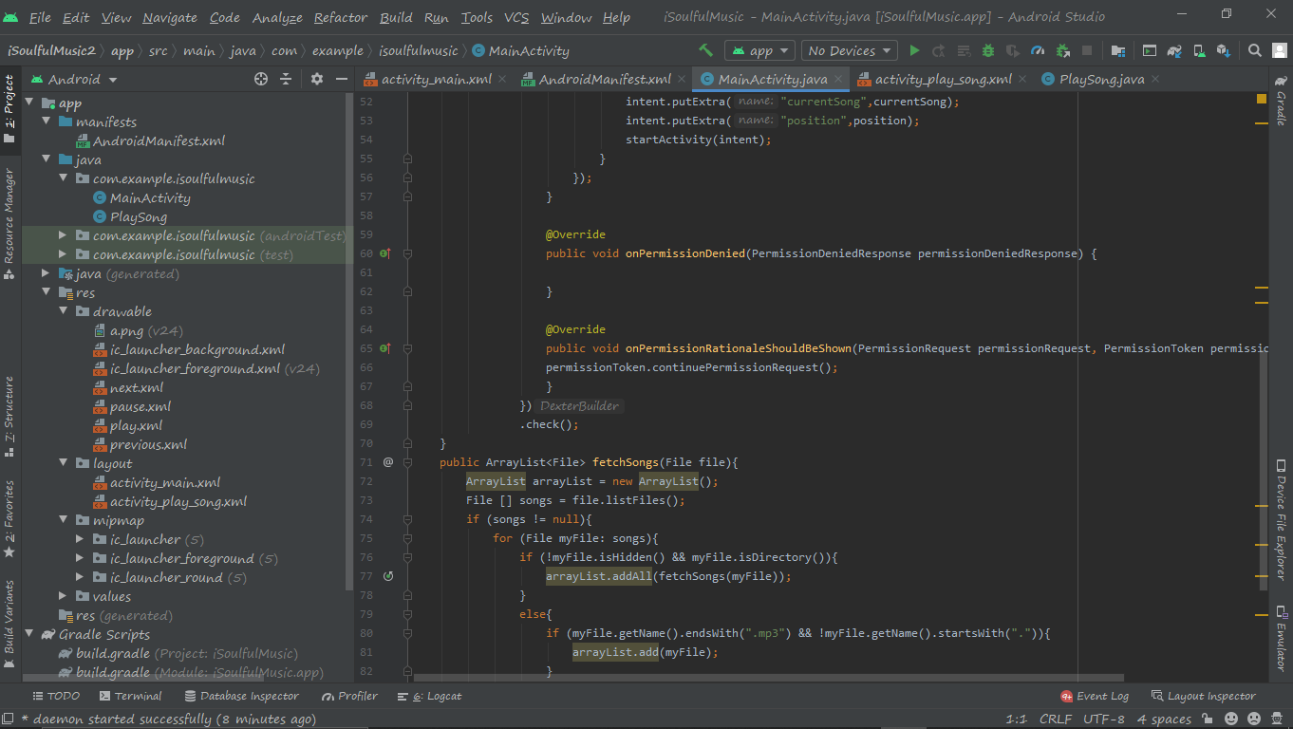

Slide 10
FrontEnd Activity2(play song)
I made a Second Activity named Play Song in which I inserted ImageView, TextView, SeekBar, Linear Layout, ImageView Asset by multiscreening app. When user will tap on any list song it will come on second activity (Activity 2) and then the song will play. Image View is for designing. TextView is for showing the text of the song , seekbar is for changing the duration of the music and image assets is for going on next song or previous song or play or pause the song.

Slide 11
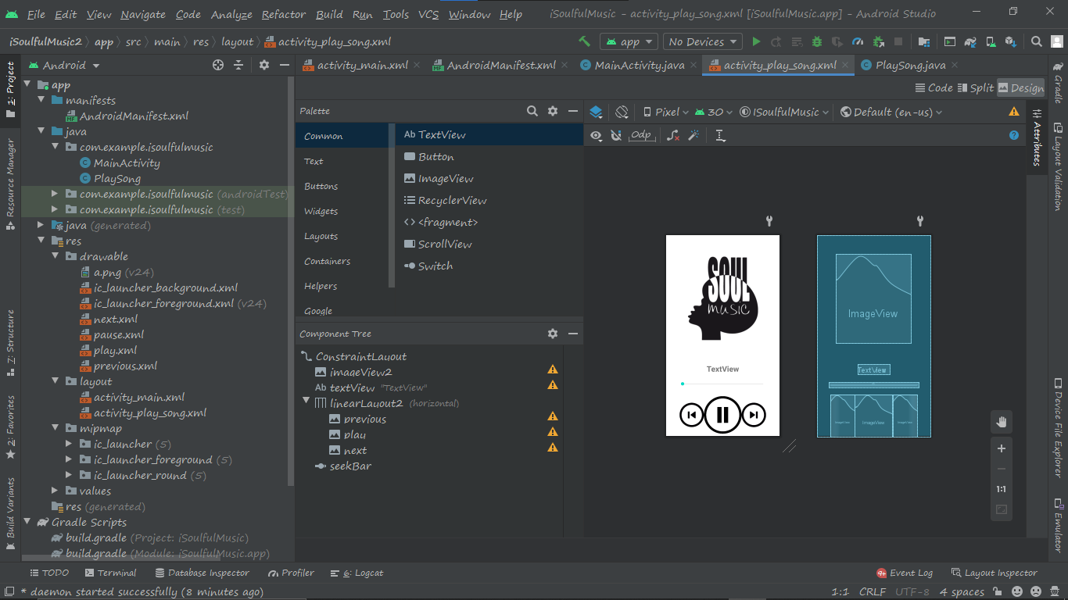

Slide 12
BackEnd Java for Activity2
I wrote all the things which I took in activity 2 and then I converted image assets in button by going in file of image asset and then I wrote if else condition to performing the play and pause button in music and then I attached seekbar with linear layout and set with duration. In Last I attached textview with list song which will be play in current list and then I made a logo by logo asset. That is all about iSoulfulMusic.

Slide 13
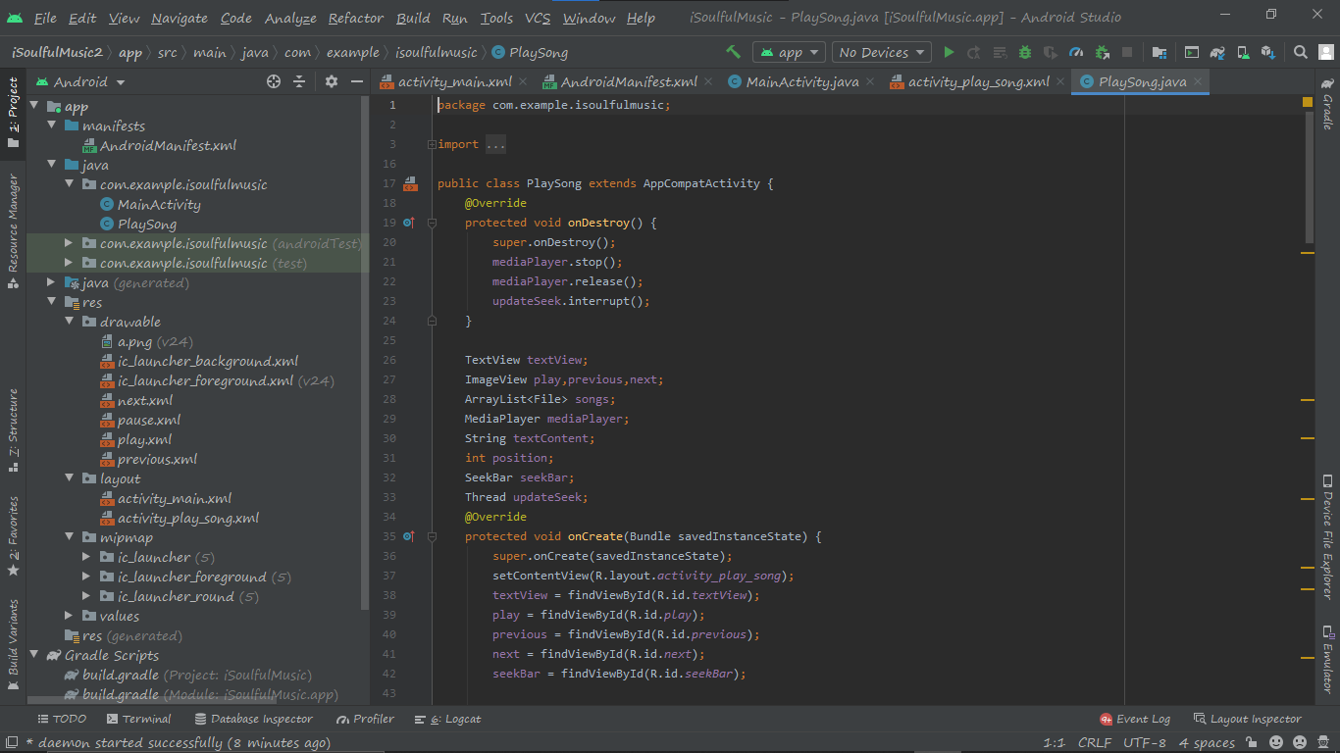

Slide 14
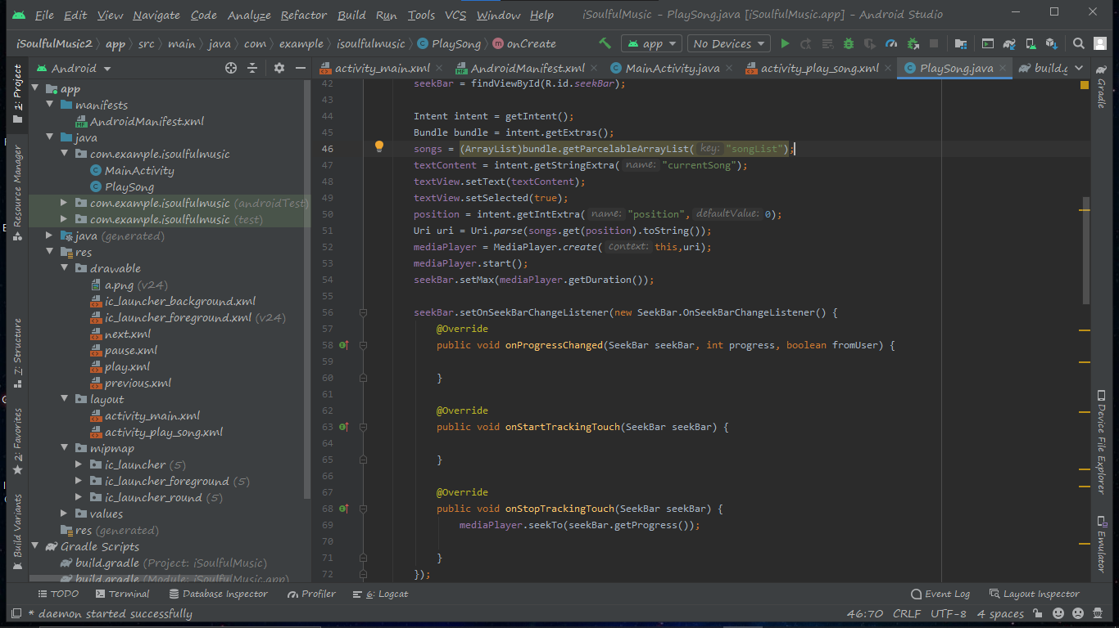

Slide 15
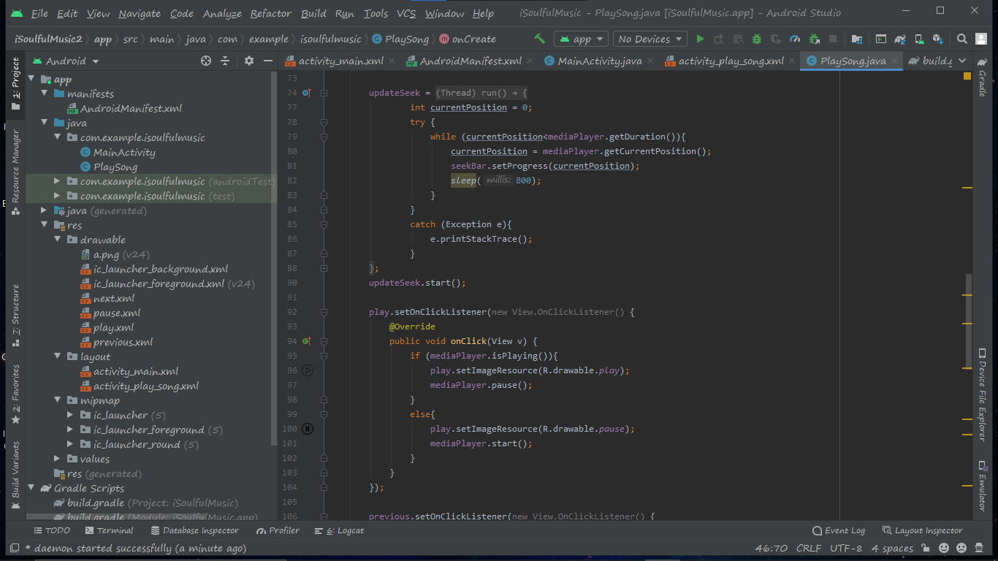

Slide 16
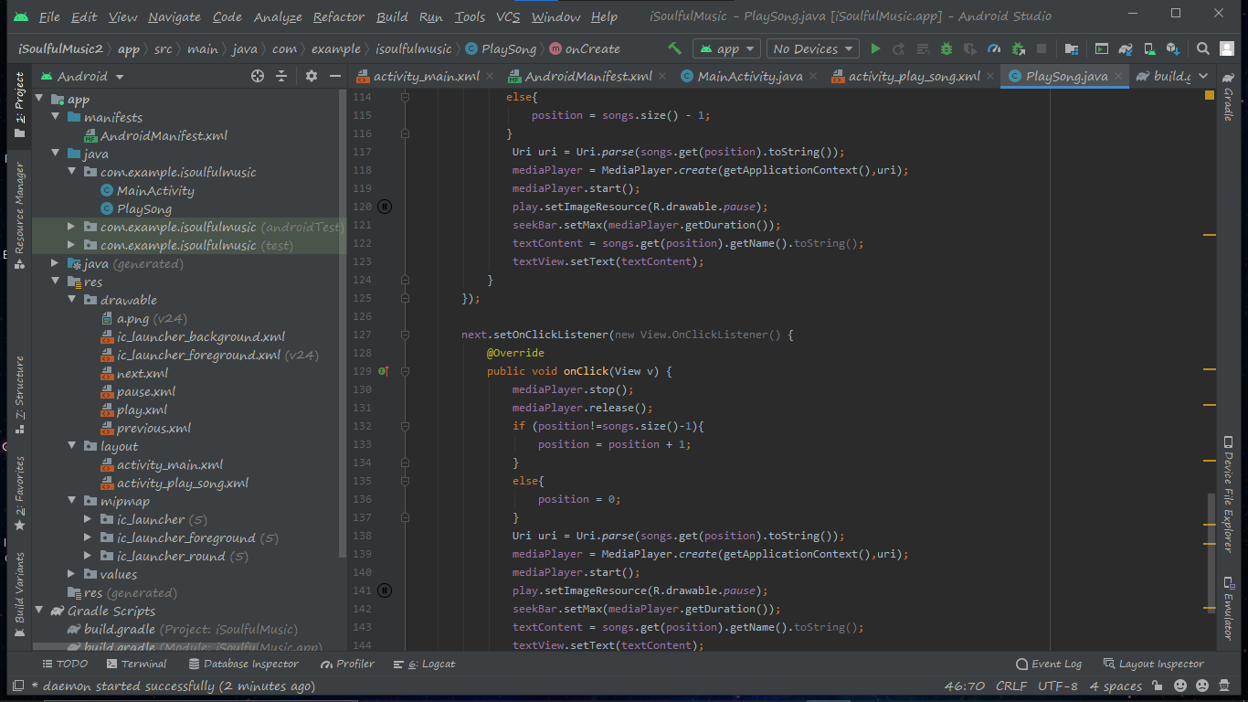

Slide 17
Opening The App(iSoulfulMusic)

Slide 18
